Slide 1
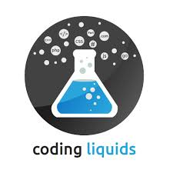
Data Science And Machine Learning
Using Python3
Workshop
By
-:Instructor:-
Dipaditya Das.

Slide 2
Agenda
What is Data Science?
How Data Science is transforming the world?
Why use Python?
Basic Python operation
Standard Python Tools to implement Data Science

Slide 3
What is Data Science ?
Data science is a multi-disciplinary field that uses scientific methods, processes, algorithms and systems to extract knowledge and insights from structured and unstructured data. Data science is the same concept as data mining and big data: "use the most powerful hardware, the most powerful programming systems, and the most efficient algorithms to solve problems".
"We have lots of data – now what?"
(How can we unlock real value from our data?)

Slide 4
Who are Data Scientists ?
The term “data scientist” was coined as recently as 2008 when companies realized the need for data professionals who are skilled in organizing and analysing massive amounts of data. In a 2009 McKinsey&Company article, Hal Varian, Google's chief economist and UC Berkeley professor of information sciences, business, and economics, predicted the importance of adapting to technology’s influence and reconfiguration of different industries.
“The ability to take data — to be able to understand it, to process it, to extract value from it, to visualize it, to communicate it — that’s going to be a hugely important skill in the next decades.”
Hal Varian, chief economist at Google and UC Berkeley professor of information sciences, business, and economics

Slide 5
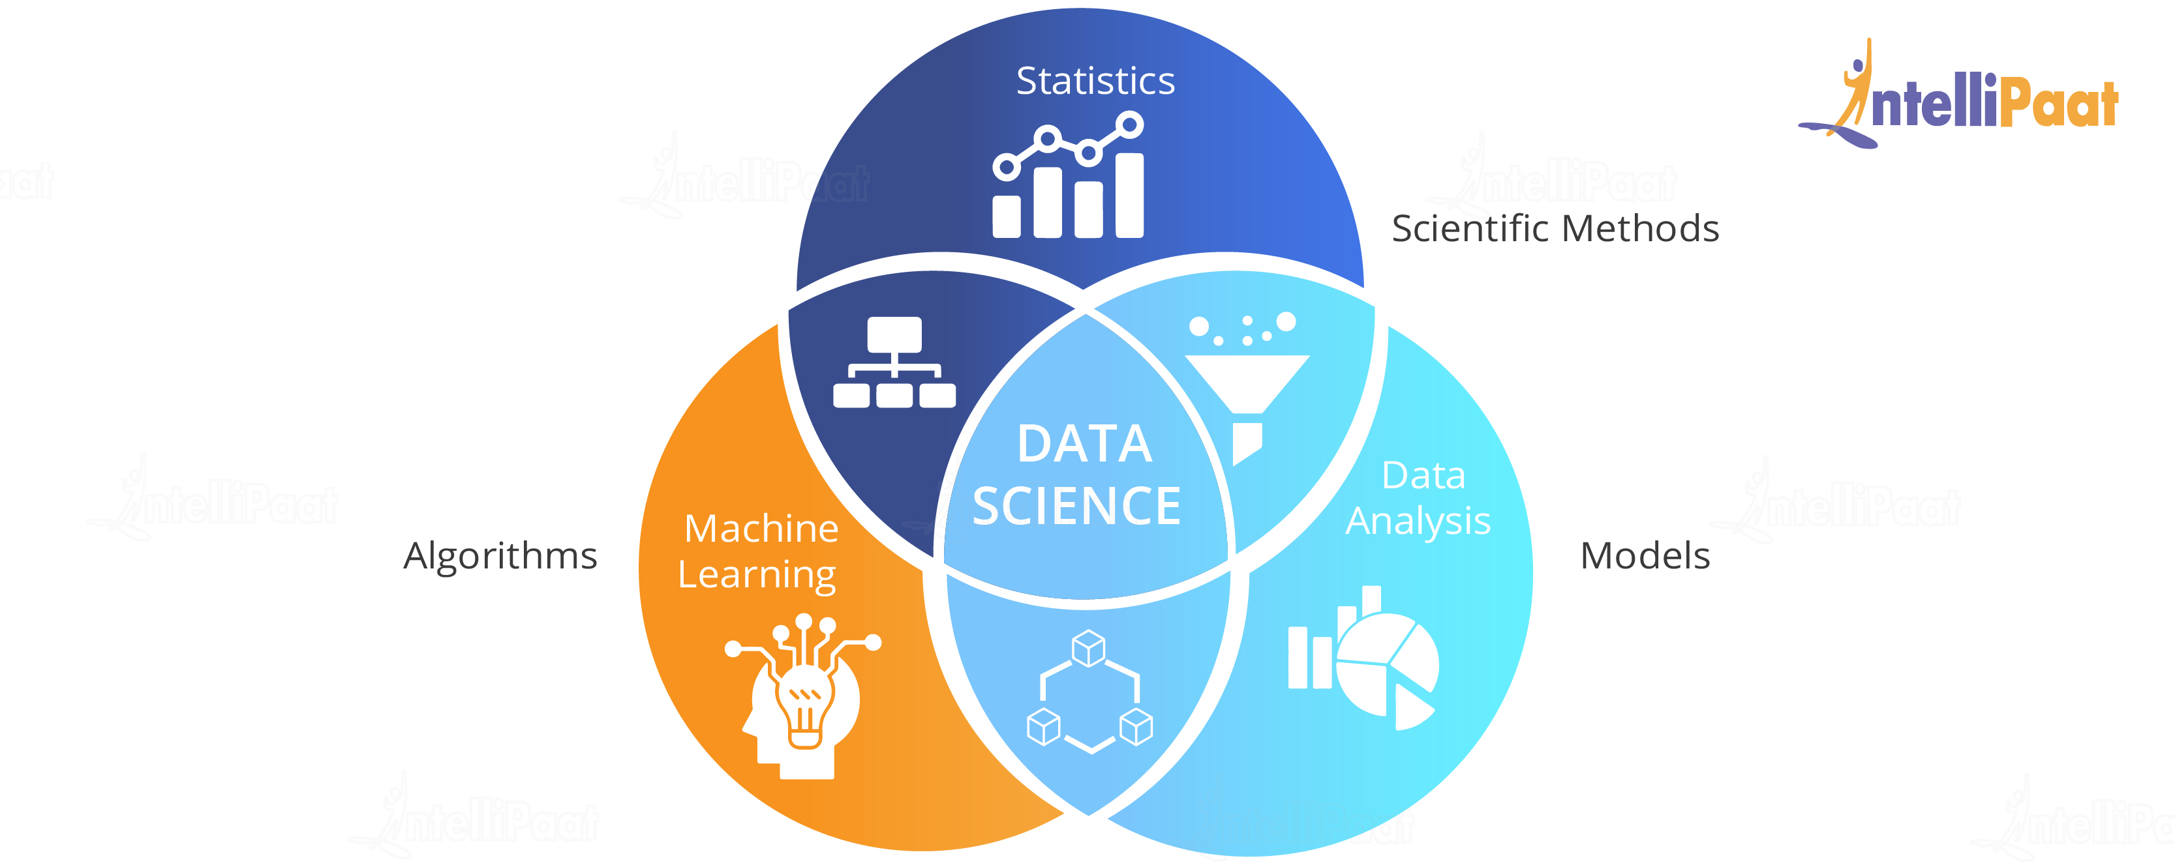
A Complete Overview of Data Science

Slide 6
After Learning Data Science?
Data Scientist - Data scientists examine which questions need answering and where to find the related data. They have business acumen and analytical skills as well as the ability to mine, clean, and present data. Businesses use data scientists to source, manage, and analyze large amounts of unstructured data. Results are then synthesized and communicated to key stakeholders to drive strategic decision-making in the organization.
Data Analyst - Data analysts bridge the gap between data scientists and business analysts. They are provided with the questions that need answering from an organization and then organize and analyze data to find results that align with high-level business strategy.

Slide 7
After Learning Data Science?
Data Engineer - Data engineers manage exponential amounts of rapidly changing data. They focus on the development, deployment, management, and optimization of data pipelines and infrastructure to transform and transfer data to data scientists for querying.

Slide 8
Python
Python is an interpreted, high-level, general-purpose programming language. Created by Guido van Rossum and first released in 1991, Python's design philosophy emphasizes code readability with its notable use of significant whitespace. Its language constructs and object-oriented approach aim to help programmers write clear, logical code for small and large-scale projects.
Python was conceived in the late 1980s by Guido van Rossum at Centrum Wiskunde & Informatica (CWI) in the Netherlands as a successor to the ABC language (itself inspired by SETL),capable of exception handling and interfacing with the Amoeba operating system. Its implementation began in December 1989.

Slide 9
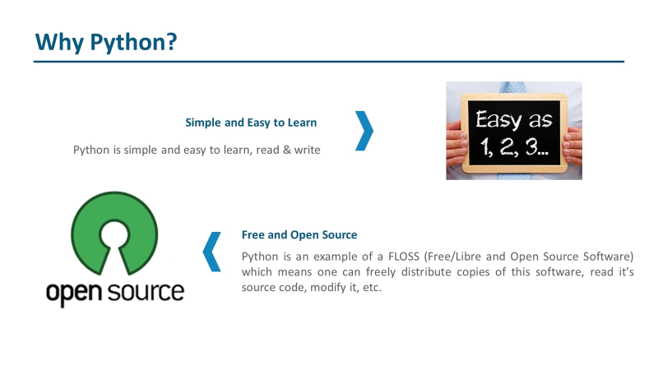
Python is a high-level, interpreted, interactive and object-oriented scripting language. Python is designed to be highly readable. It uses English keywords frequently where as other languages use punctuation, and it has fewer syntactical constructions than other languages.
Python is Interpreted − Python is processed at runtime by the interpreter. You do not need to compile your program before executing it. This is similar to PERL and PHP.
Python is Interactive − You can actually sit at a Python prompt and interact with the interpreter directly to write your programs.
Python is Object-Oriented − Python supports Object-Oriented style or technique of programming that encapsulates code within objects.
Python is a Beginner's Language − Python is a great language for the beginner-level programmers and supports the development of a wide range of applications from simple text processing to WWW browsers to games.

Slide 10


Slide 11
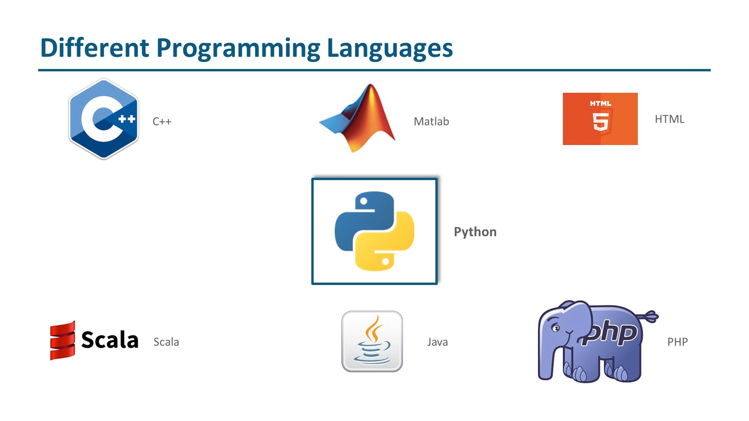

Slide 12
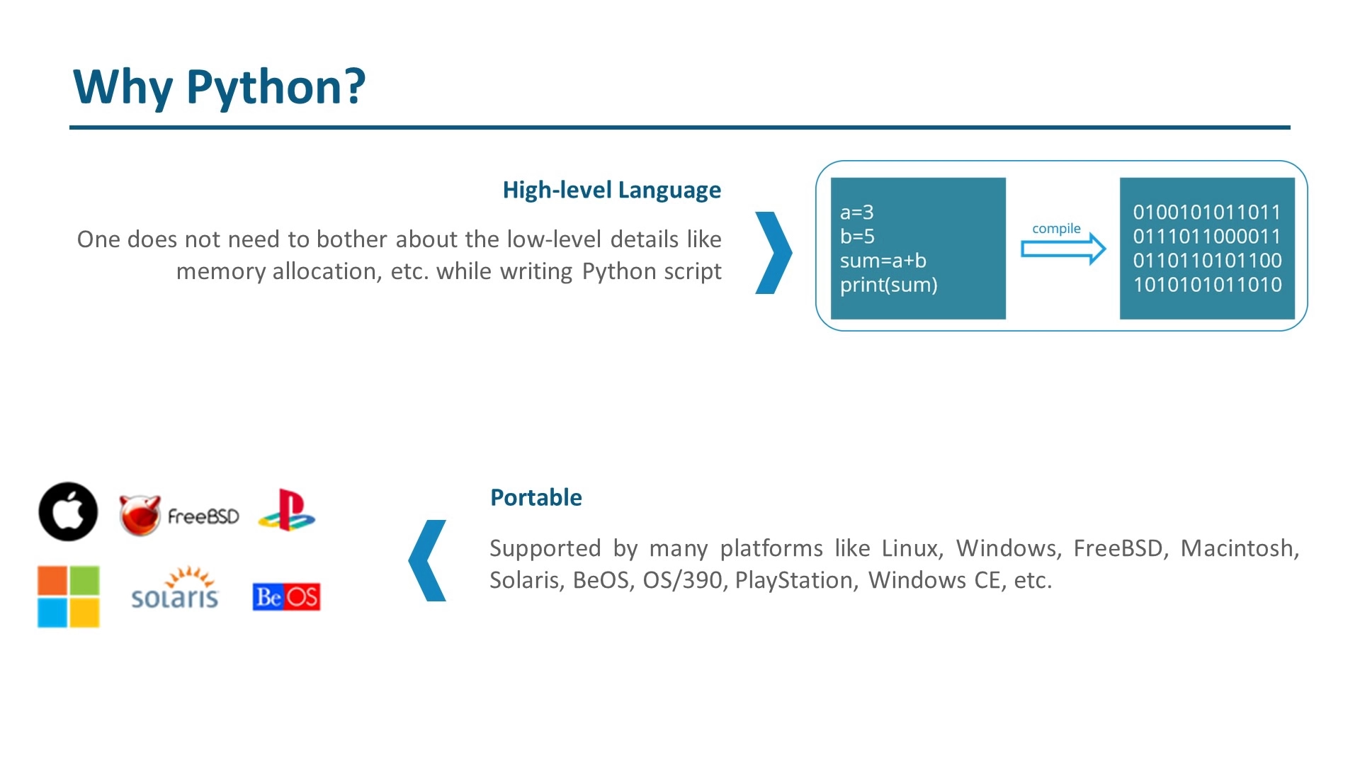

Slide 13
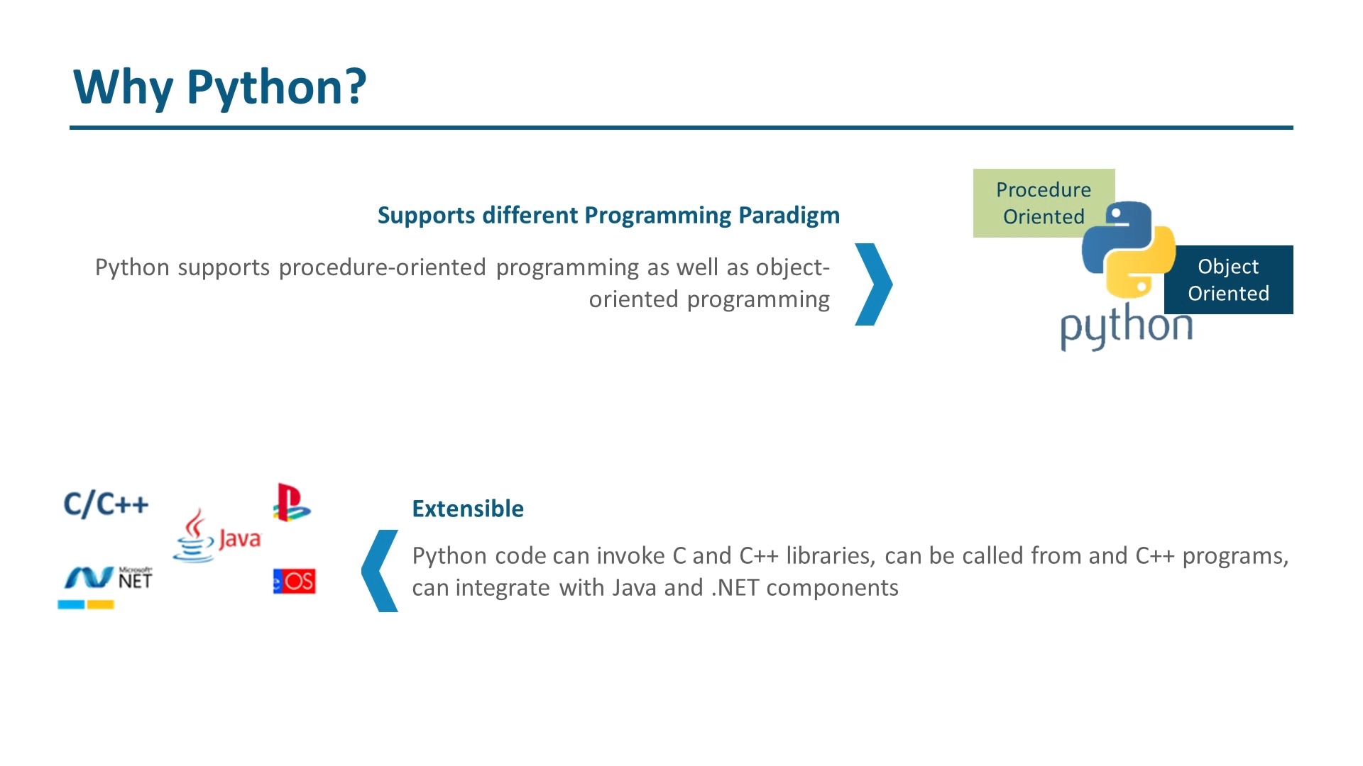

Slide 14
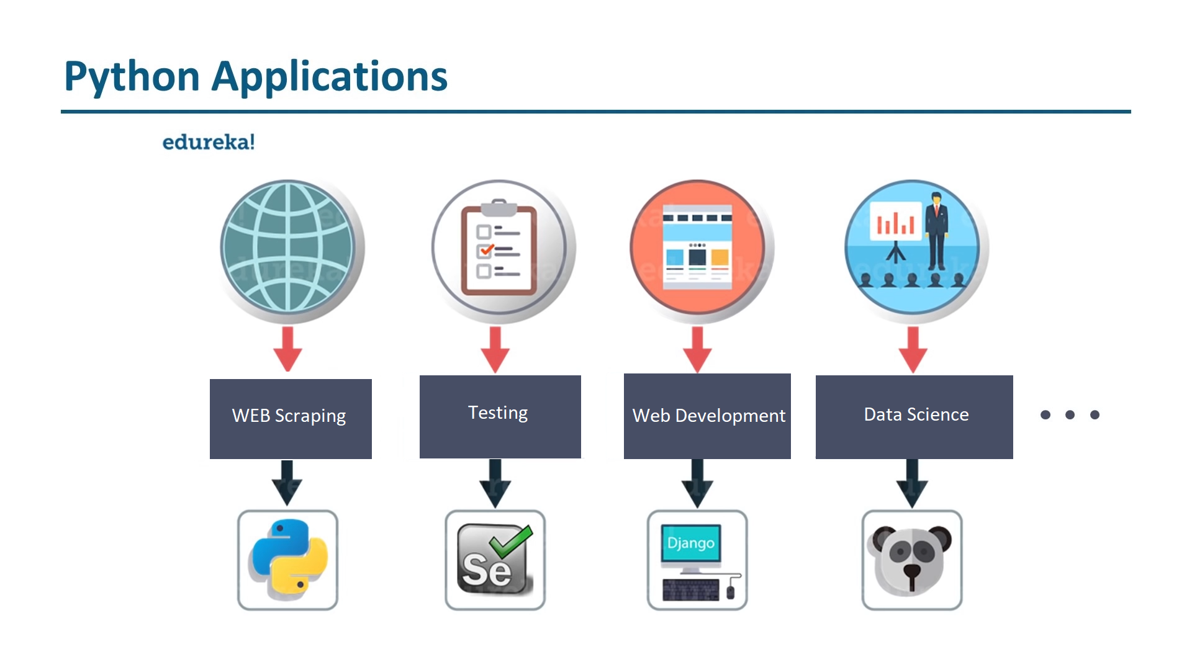

Slide 15
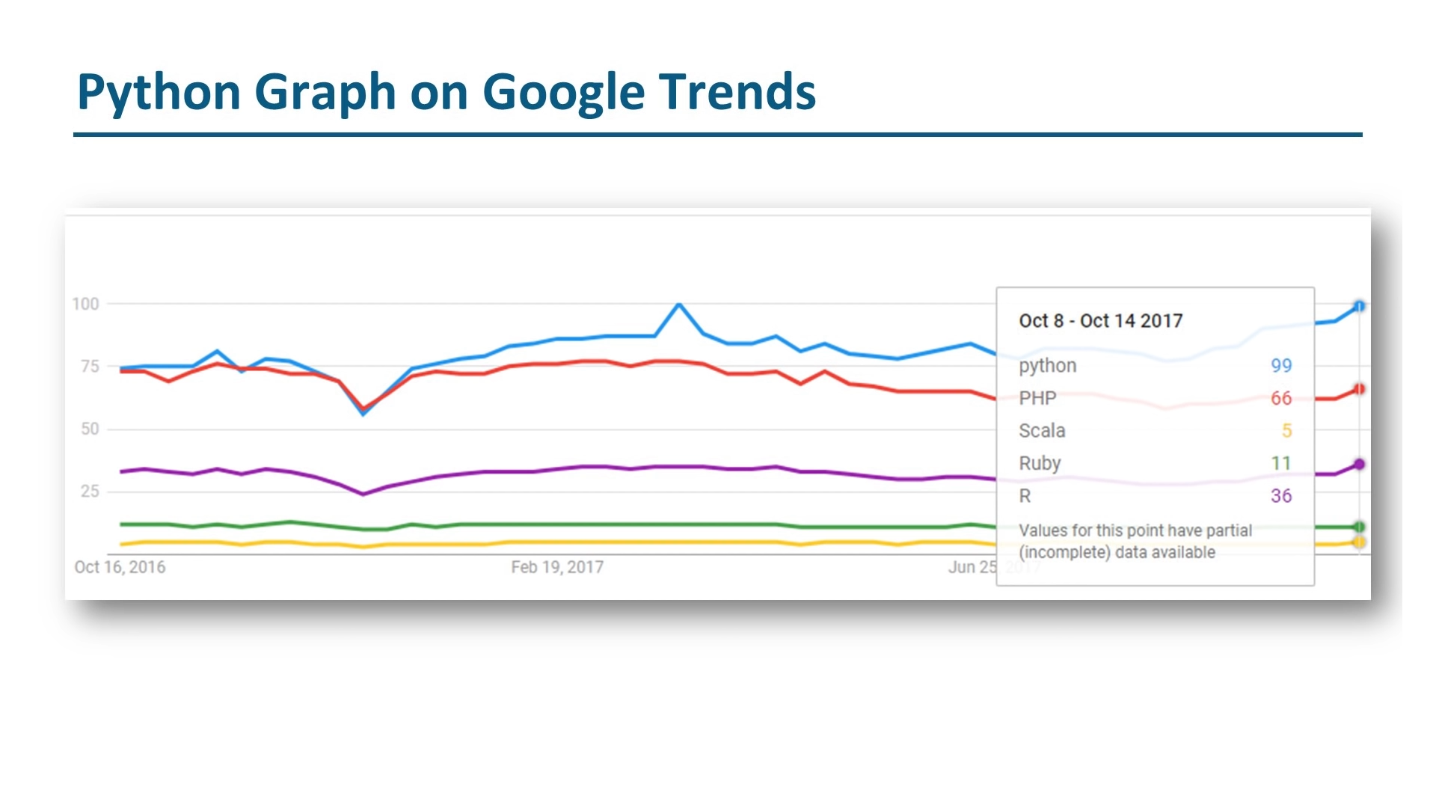

Slide 16
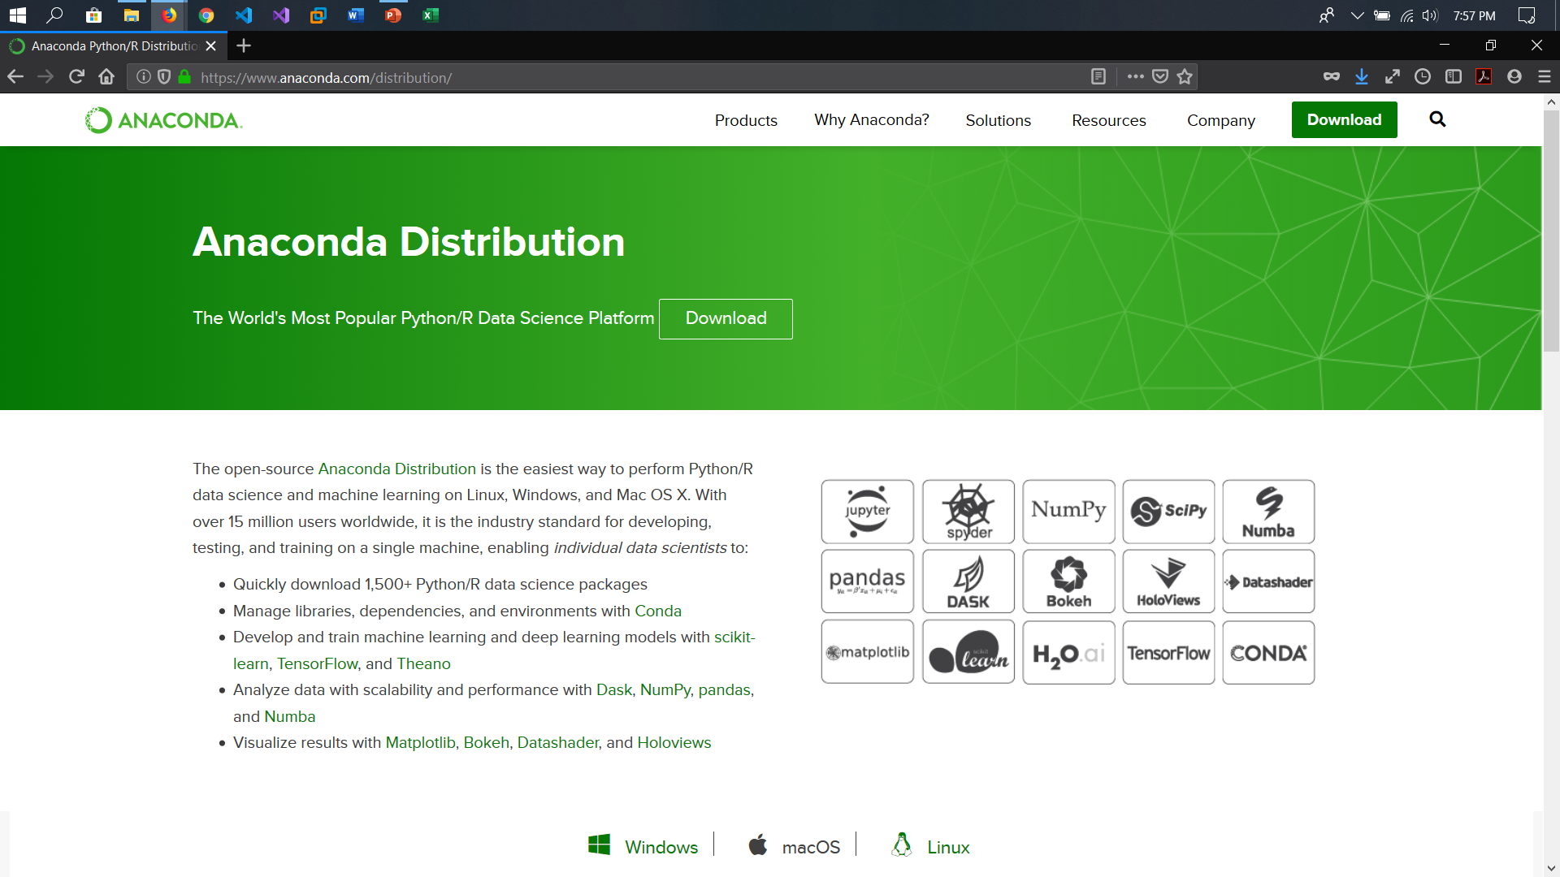

Slide 17
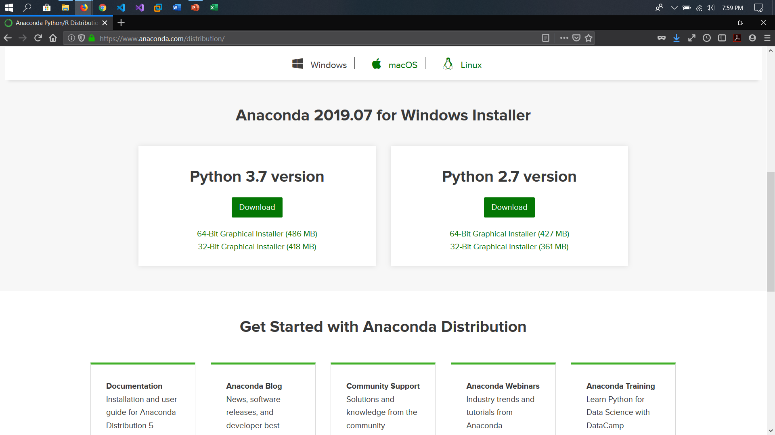

Slide 18
Jupyter Lab
JupyterLab is a next-generation web-based user interface for Project Jupyter.
JupyterLab enables you to work with documents and activities such as Jupyter notebooks, text editors, terminals, and custom components in a flexible, integrated, and extensible manner. You can arrange multiple documents and activities side by side in the work area using tabs and splitters. Documents and activities integrate with each other, enabling new workflows for interactive computing, for example:
Code Consoles provide transient scratchpads for running code interactively, with full support for rich output. A code console can be linked to a notebook kernel as a computation log from the notebook, for example.
Kernel-backed documents enable code in any text file (Markdown, Python, R, LaTeX, etc.) to be run interactively in any Jupyter kernel.
Notebook cell outputs can be mirrored into their own tab, side by side with the notebook, enabling simple dashboards with interactive controls backed by a kernel.
Multiple views of documents with different editors or viewers enable live editing of documents reflected in other viewers. For example, it is easy to have live preview of Markdown, Delimiter-separated Values, or Vega/Vega-Lite documents.

Slide 19
Google Colab
Colaboratory is a free Jupyter notebook environment that requires no setup and runs entirely in the cloud.
With Colaboratory you can write and execute code, save and share your analyses, and access powerful computing resources, all for free from your browser.
It has all the features of Jupyter Notebook.

Slide 20
Basic Python Operations

Slide 21
NumPy
NumPy, which stands for Numerical Python, is a library consisting of multidimensional array objects and a collection of routines for processing those arrays.
Using NumPy, mathematical and logical operations on arrays can be performed.
Operations using NumPy
Using NumPy, a developer can perform the following operations −
Mathematical and logical operations on arrays.
Fourier transforms and routines for shape manipulation.
Operations related to linear algebra. NumPy has in-built functions for linear algebra and random number generation.

Slide 22
Pandas
pandas is a Python package providing fast, flexible, and expressive data structures designed to make working with “relational” or “labeled” data both easy and intuitive. It aims to be the fundamental high-level building block for doing practical, real world data analysis in Python. Additionally, it has the broader goal of becoming the most powerful and flexible open source data analysis / manipulation tool available in any language. It is already well on its way toward this goal.
pandas is well suited for many different kinds of data:
Tabular data with heterogeneously-typed columns, as in an SQL table or Excel spreadsheet
Ordered and unordered (not necessarily fixed-frequency) time series data.
Arbitrary matrix data (homogeneously typed or heterogeneous) with row and column labels
Any other form of observational / statistical data sets. The data actually need not be labeled at all to be placed into a pandas data structure

Slide 23
Matplotlib
Matplotlib is a plotting library for the Python programming language and its numerical mathematics extension NumPy. It provides an object-oriented API for embedding plots into applications using general-purpose GUI toolkits like Tkinter, wxPython, Qt, or GTK+. There is also a procedural "pylab" interface based on a state machine (like OpenGL), designed to closely resemble that of MATLAB, though its use is discouraged. SciPy makes use of Matplotlib.
Matplotlib was originally written by John D. Hunter, has an active development community, and is distributed under a BSD-style license. Michael Droettboom was nominated as matplotlib's lead developer shortly before John Hunter's death in August 2012, and further joined by Thomas Caswell.

Slide 24
Seaborn
Seaborn is a library for making statistical graphics in Python. It is built on top of matplotlib and closely integrated with pandas data structures.
Seaborn aims to make visualization a central part of exploring and understanding data. Its dataset-oriented plotting functions operate on dataframes and arrays containing whole datasets and internally perform the necessary semantic mapping and statistical aggregation to produce informative plots.

Slide 25
Let’s Get Started

